Slide 1

Thesis supervisor Agnès Bonvilain
Design and control of a tracheal
occlusion system for an
implantable active artificial larynx
Presented by: Adrien Mialland
ORL surgeon: Ihab Atallah
Host laboratoiry : Grenoble Image Parole Signal Automatique (Gipsa-Lab)
Université Grenoble Alpes (UGA)

Slide 2
Presentation Plan
Context
Clinical Research Protocol (CRP)
Statistical Study
Real time detection
Implantable Active Artificiel larynx (IAAL)
Conclusion and perspectives

Slide 3
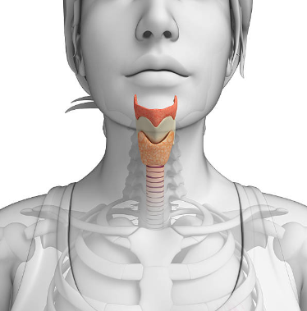
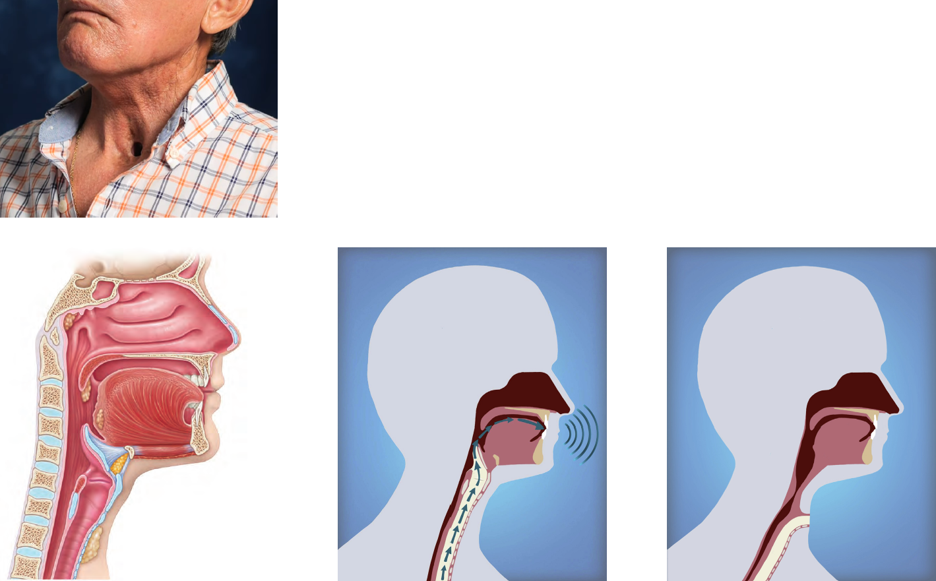
1. Context - larynx
larynx
thyroid
epiglotte
trachea
œsophagus
larynx
Vocal cordes
thyroid
trachea
E. Maried et al. 2013
3 main functions:
Breathing – Swallowing - Phonation

Slide 4
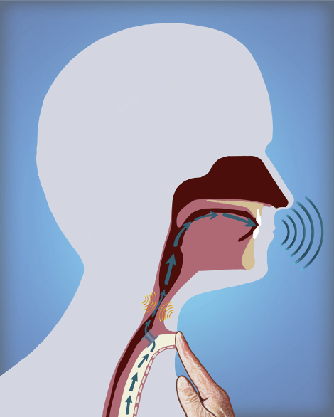
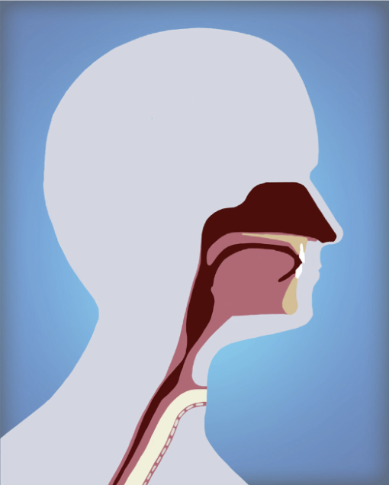
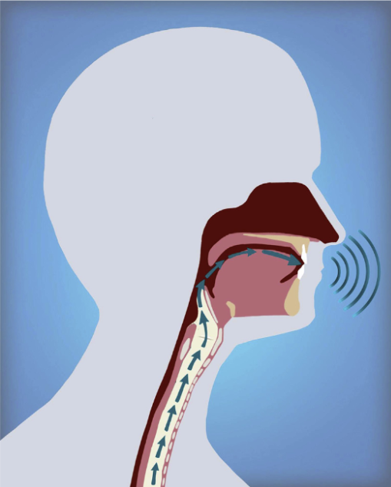




1. Context – Total Laryngectomy
larynx
Rehabilitation methods:
Tracheostomy.
Voice restoration.
œsophage
trachéostomie
trachée
Christopher G. Tang et al. 2015.

Slide 5
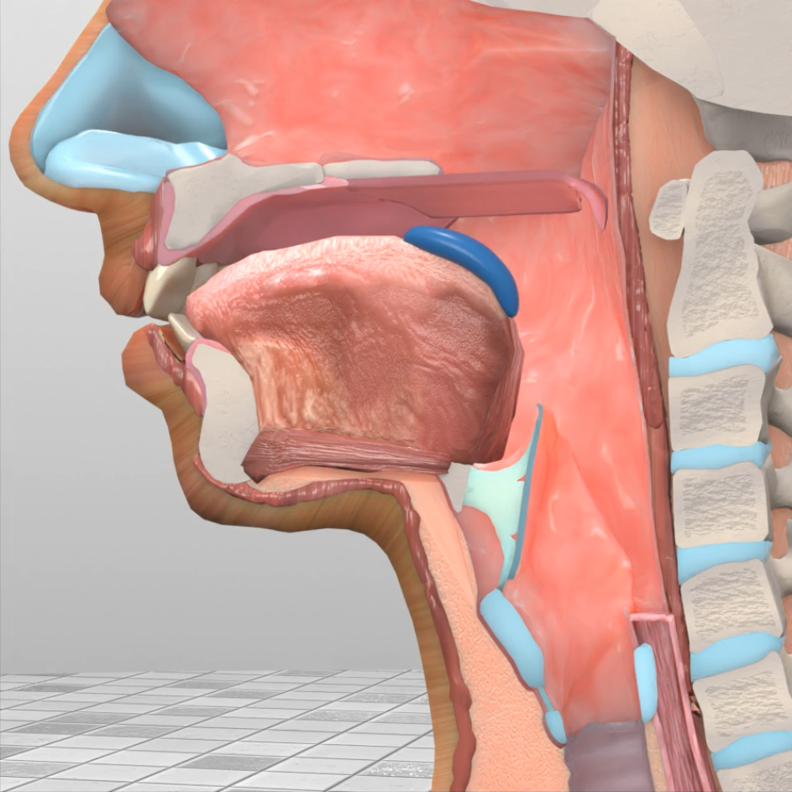
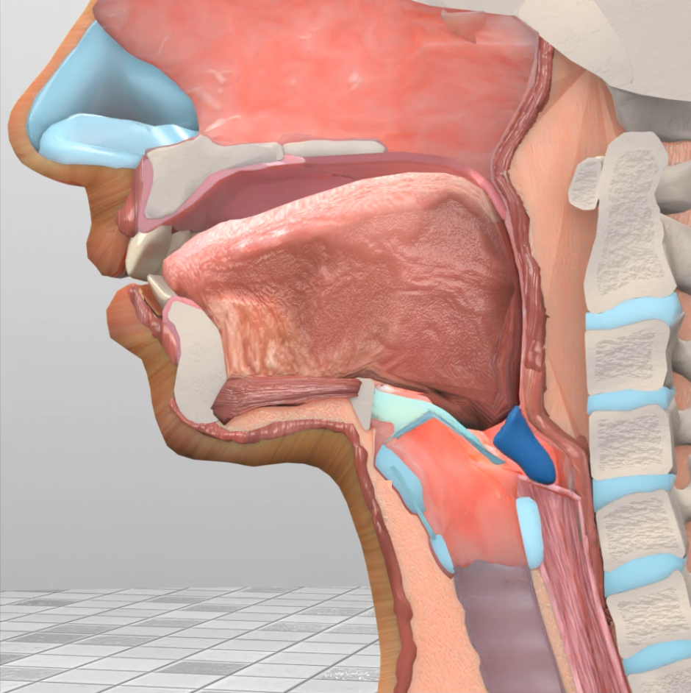
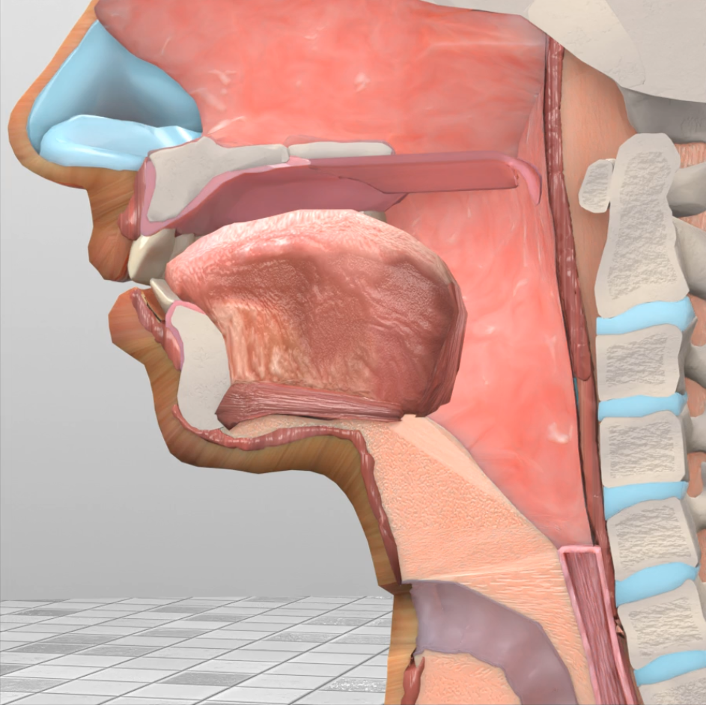
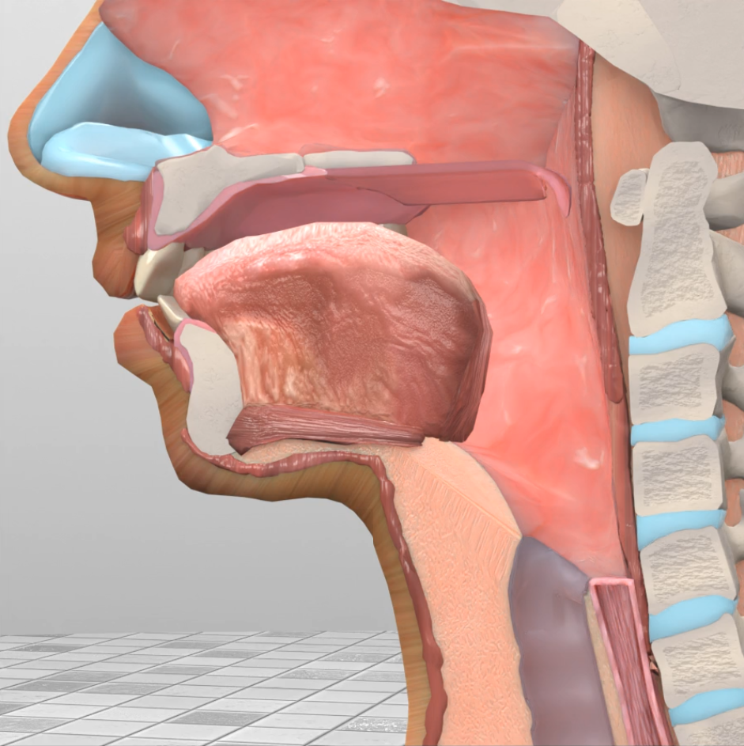
1. Context – Swallowing Restoration
Larynx
œsophagus
trachea

Slide 6

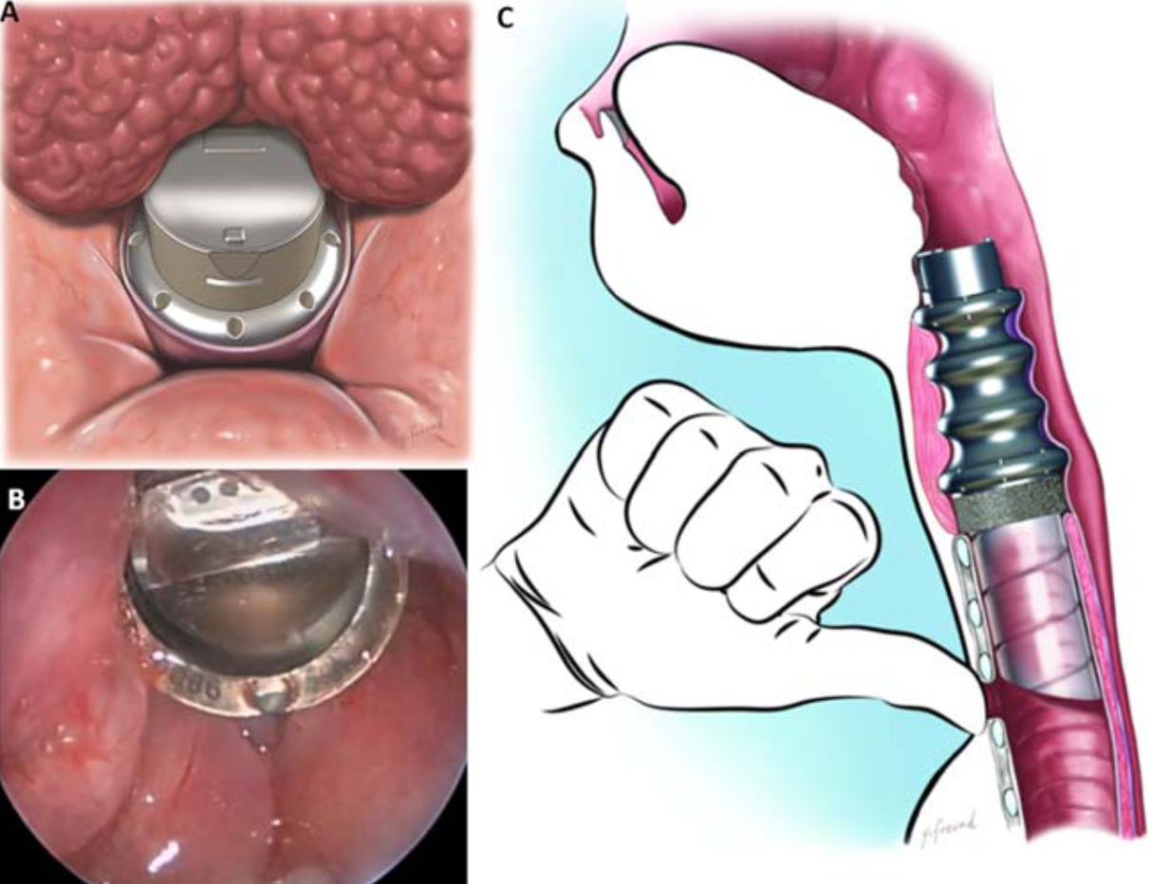
1. Context – Swallowing Restoration
Larynx
œsophage
trachée
View from
A et B
First Artificial Larynx - 2012:
Valve mechanism - passive,
Implanted on 6 patients,
Only used under medical control,
Lack of sealing
Debry C. et al. 2014.

Slide 7
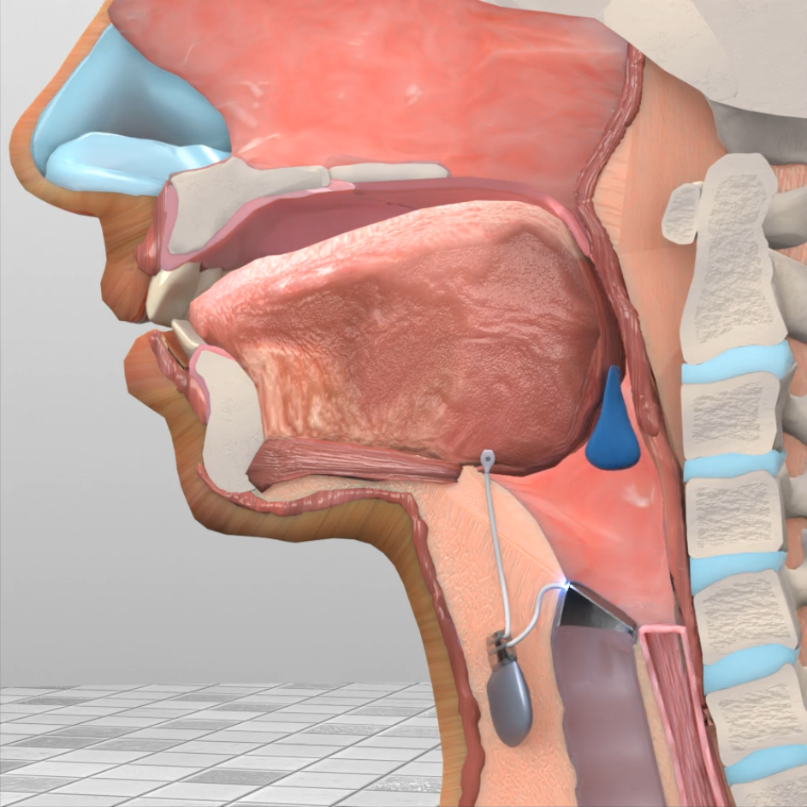
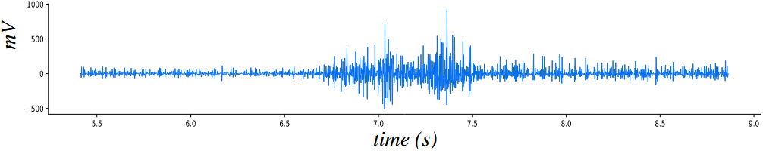
1. Context – Swallowing Restoration
Larynx
œsophage
trachea
Example of a swallowing signal
Real time detection - constraints:
Earliness
Accuracy
Preservation
Consomption
Start of
Swallowing ?
Available
Time ?
Tends to be dedicated to swallowing ?
Start
Detection
limit
End
Time (s)

Slide 8
Presentation Plan
Context
Clinical Research Protocol (CRP)
Statistical Study
Real time detection
Implantable Active Artificiel larynx (IAAL)
Conclusion and perspectives

Slide 9
2. CRP – Main criteria: earliness
Example of a swallowing signal
Time (s)
Start of
swallowing
Moment of activation of
Measured muscles
Detection
limit
Time
Interval of activation of
measured muscles
Signal
processing
Actuation of
the system

Slide 10
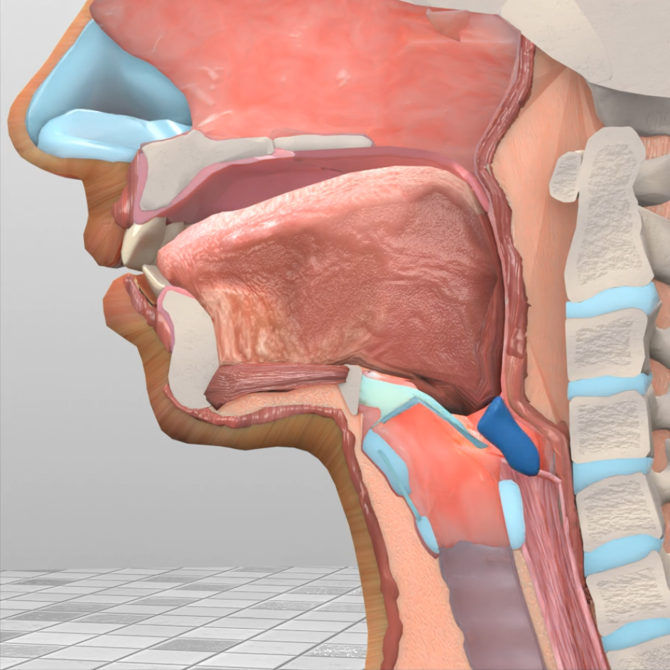
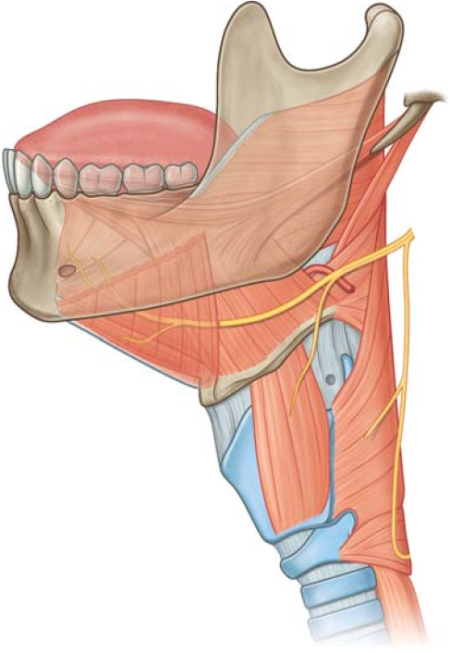
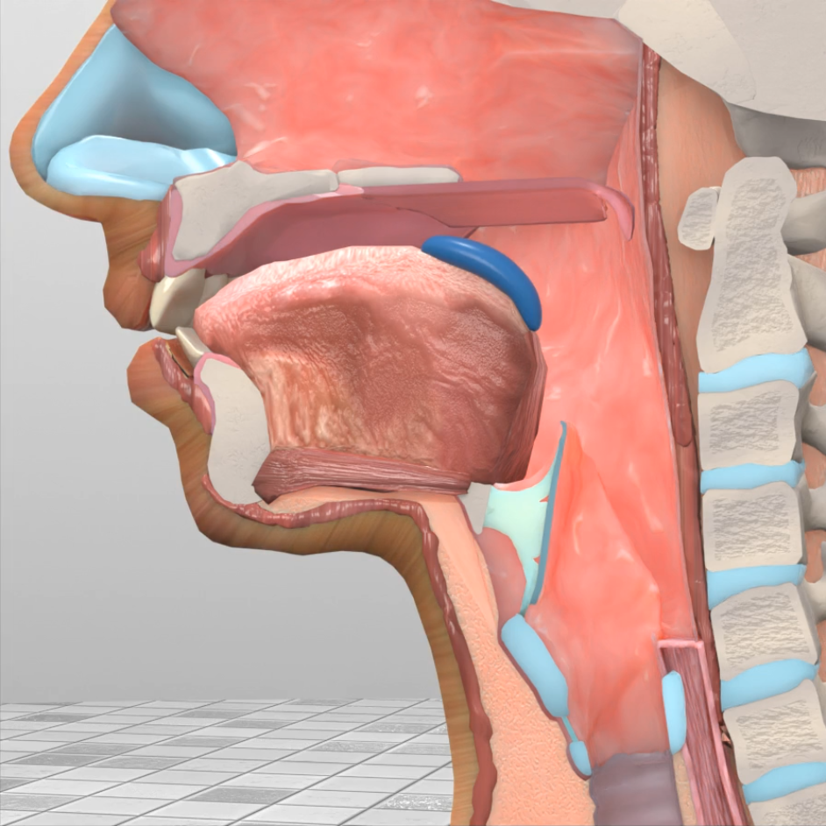
2. CRP – Main criteria: earliness
Pharyngeal Muscles:
Superior constrictor
Middle constrictor
Inferior constrictor
Submandibular
muscles
epiglotte
Hyoid Bone
Upper oesophageal sphincter
trachea
œsophagus
Start of
swallowing
Moment of activation of
Measured muscles
Detection
limit
Time
Interval of activation of
measured muscles
Signal
processing
Actuation of
the system

Slide 11
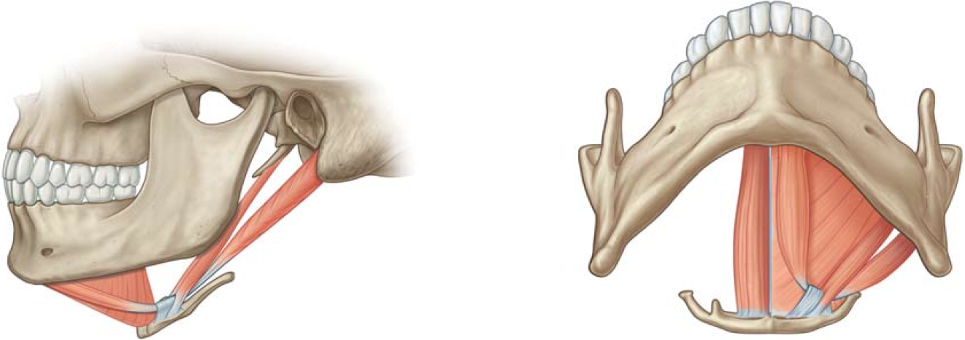
2. CRP – Start of Swallowing
[D. Park et al. 2017, J. Walton et al. 2018, R. L. Drake et al. 2010]
Submandibular
muscles
Mylohyoid
Anterior bely of the digastric
Hyoid bone
Geniohyoid
Hyoid Bone
Hyoid bone
Upper oesophageal sphincter
Anterior belly of the digastric
Mylohyoid
Submandibular
Start of
swallowing
Moment of activation of
Measured muscles
Detection
limit
Time
Interval of activation of
measured muscles
Signal
processing
Actuation of
the system
A. Mialland et al. Toward a robust swallowing detection for an implantable active artificial larynx: A survey. In: Med. Biol. Eng. Comput. (2023).

Slide 12
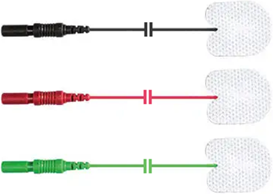
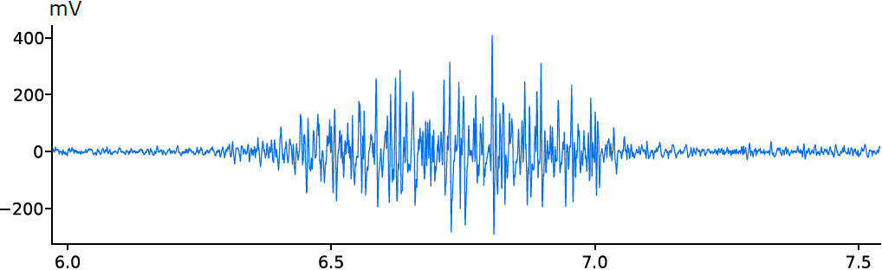
2. CRP – Start of Swallowing
Surface electromyography electrodes
Submandibular
muscles
400
mV
200
Hyoid Bone
0
Upper oesophageal sphincter
-200
second
6.0
6.5
7.0
7.5
Start of
swallowing
Moment of activation of
Measured muscles
Detection
limit
Time
Interval of activation of
measured muscles
Signal
processing
Actuation of
the system

Slide 13
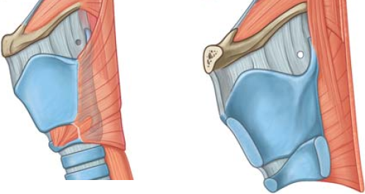
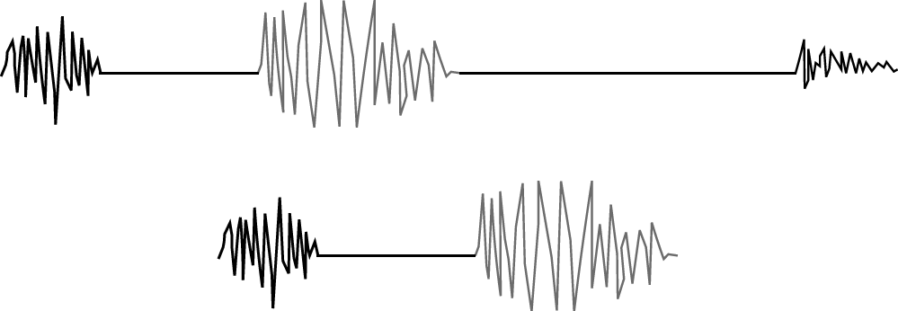
2. CRP – Temporal detection limit
[Morinière et al. 2011, M. Hasegawa et al. 2018, T. Omari et al 2018, A. Pal et al. 2003, J. Lee et al. 2008, J. M. Dudik et al. 2015]
Before total laryngectomy
Submandibular
muscles
Pharyngeal
component
Upper oesophageal sphincter component
Laryngeal opening
component
cricoid cartilage
Upper oesophageal sphincter
Hyoid Bone
Upper oesophageal sphincter
Start of
swallowing
Moment of activation of
Measured muscles
Detection
limit
Time
Interval of activation of
measured muscles
Signal
processing
Actuation of
the system

Slide 14
2. CRP – Temporal detection limit
[Morinière et al. 2011, M. Hasegawa et al. 2018, T. Omari et al 2018, A. Pal et al. 2003, J. Lee et al. 2008, J. M. Dudik et al. 2015]
Before total laryngectomy
Submandibular
muscles
After total laryngectomy
cricoid cartilage
Upper oesophageal sphincter
Hyoid Bone
Upper oesophageal sphincter
Start of
swallowing
Moment of activation of
Measured muscles
Detection
limit
Time
Interval of activation of
measured muscles
Signal
processing
Actuation of
the system

Slide 15
2. PRC – Stylohyoid and posterior digastric muscles
Earliness
Accuracy
Accuracy
Consumption
Consumption
Preservation
Preservation
Activation variability of the stylohyoid and posterior digastric muscles:
Activated at the same time than the submandibular muscles
EMG studies on animals [Rebecca Z. German et al. 2009, A. J. Thexton et al. 2007 , R. W. Doty et al. 1956].
Imaging study on human [T. Okada et al. 2013]
Anatomic properties study on human [W. G. Pearson et al. 2011]
Start of
swallowing
Moment of activation of
Measured muscles
Detection
limit
Time
Interval of activation of
measured muscles
Signal
processing
Actuation of
the system

Slide 16
2. PRC – Stylohyoid and posterior digastric muscles
Earliness
Accuracy
Accuracy
Consumption
Consumption
Preservation
Preservation
Stylohyoid (SH)
Posterior Digastric (PD)
Submandibular
muscles
Hyoid Bone
Start of
swallowing
Moment of activation of
Measured muscles
Detection
limit
Time
Interval of activation of
measured muscles
Signal
processing
Actuation of
the system

Slide 17
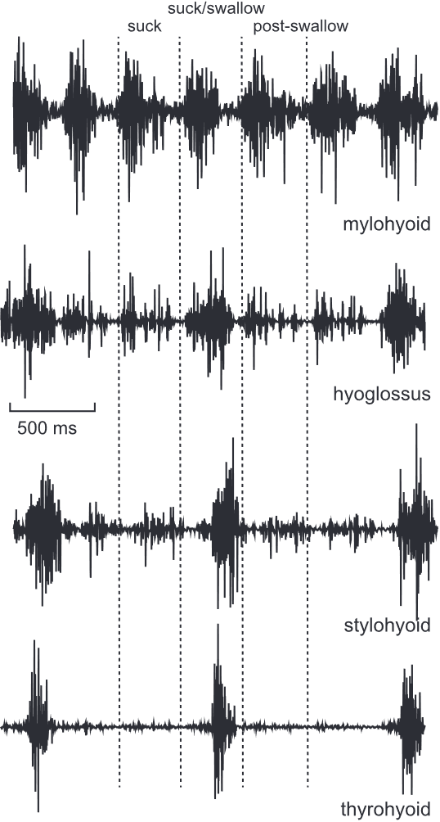
2. PRC – Stylohyoid and posterior digastric muscles
Earliness
Accuracy
Consumption
Preservation
Intramuscular EMG on pigs
A. J. Thexton et al. 2012
Start of
swallowing
Moment of activation of
Measured muscles
Detection
limit
Time
Interval of activation of
measured muscles
Signal
processing
Actuation of
the system

Slide 18
2. PRC – Stylohyoid and posterior digastric muscles
Earliness
Accuracy
Consumption
Preservation
Intramuscular EMG on pigs
Stylohyoid and posterior digastric muscles:
Predominently activate for swallowing
EMG studies on animals [Rebecca Z. German et al. 2009, C. J. Mayerl et al. 2021, A. J. Thexton et al. 2012].
Imaging study on human[W. G. Pearson et al. 2013]
Anatomic properties study on human [W. G. Pearson et al. 2011]
A. J. Thexton et al. 2012
Start of
swallowing
Moment of activation of
Measured muscles
Detection
limit
Time
Interval of activation of
measured muscles
Signal
processing
Actuation of
the system

Slide 19
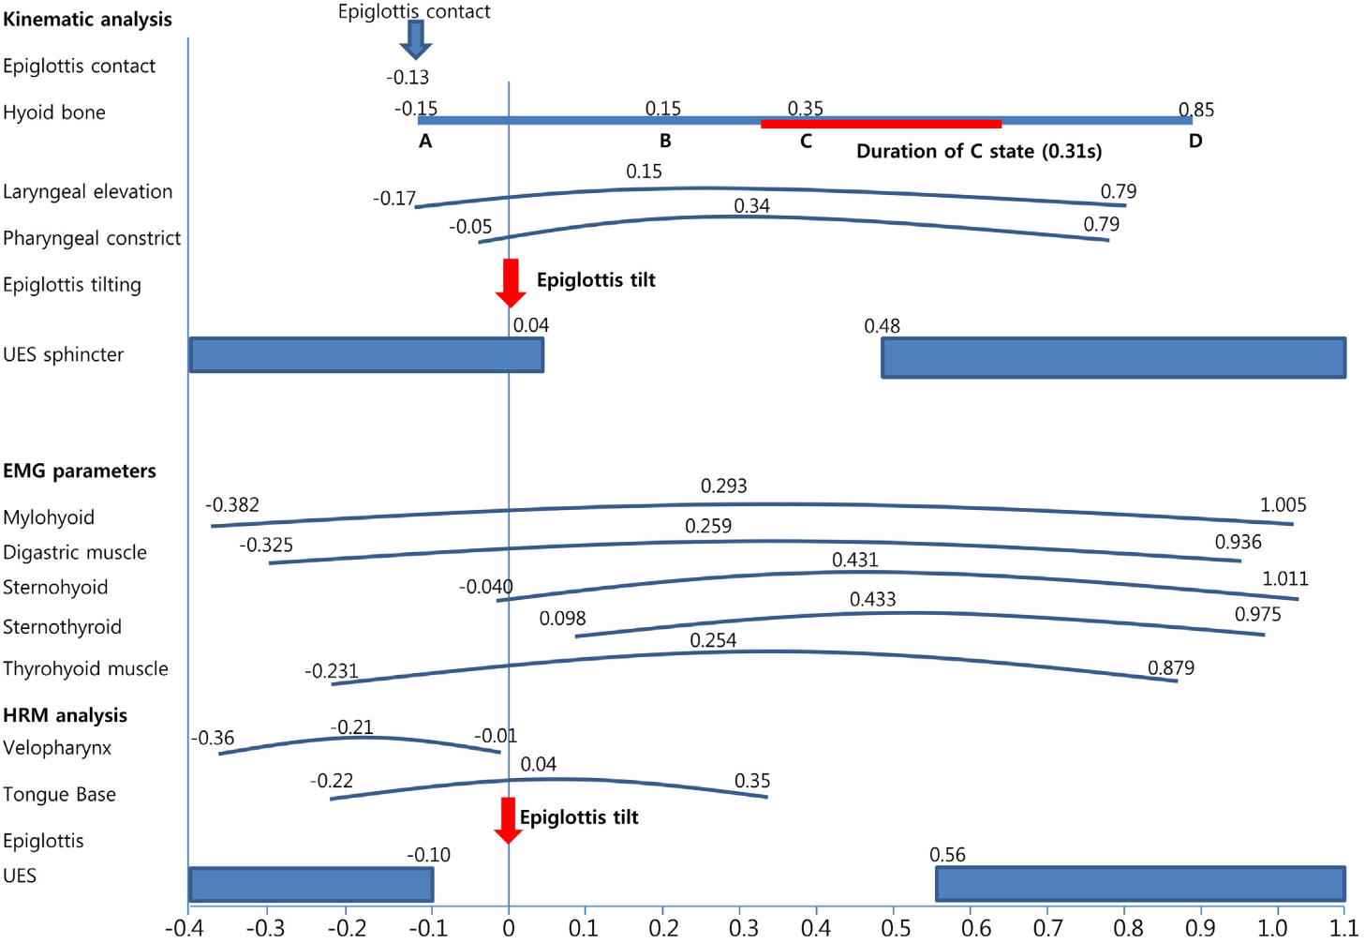
2. PRC – Stylohyoid and posterior digastric muscles
Earliness
Accuracy
Consumption
Preservation
Temps (s)
D. Park et al. 2017
Start of
swallowing
Moment of activation of
Measured muscles
Detection
limit
Time
Interval of activation of
measured muscles
Signal
processing
Actuation of
the system

Slide 20
2. PRC – Stylohyoid and posterior digastric muscles
Earliness
Accuracy
Consumption
Preservation
Temps (s)
D. Park et al. 2017
Start of
swallowing
Moment of activation of
Measured muscles
Detection
limit
Time
Interval of activation of
measured muscles
Signal
processing
Actuation of
the system

Slide 21
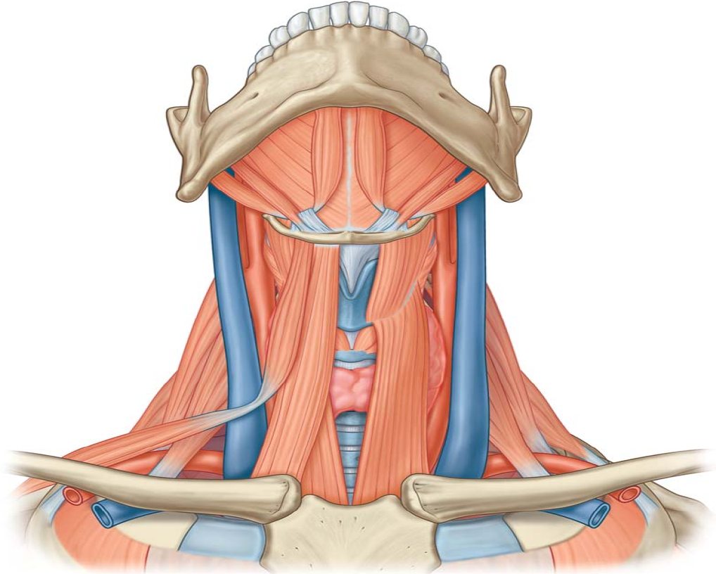
2. PRC – Stylohyoid and posterior digastric muscles
Earliness
Accuracy
Consumption
Preservation
stylohyoïdien
Digastrique
postérieur
Start of
swallowing
Moment of activation of
Measured muscles
Detection
limit
Time
Interval of activation of
measured muscles
Signal
processing
Actuation of
the system

Slide 22
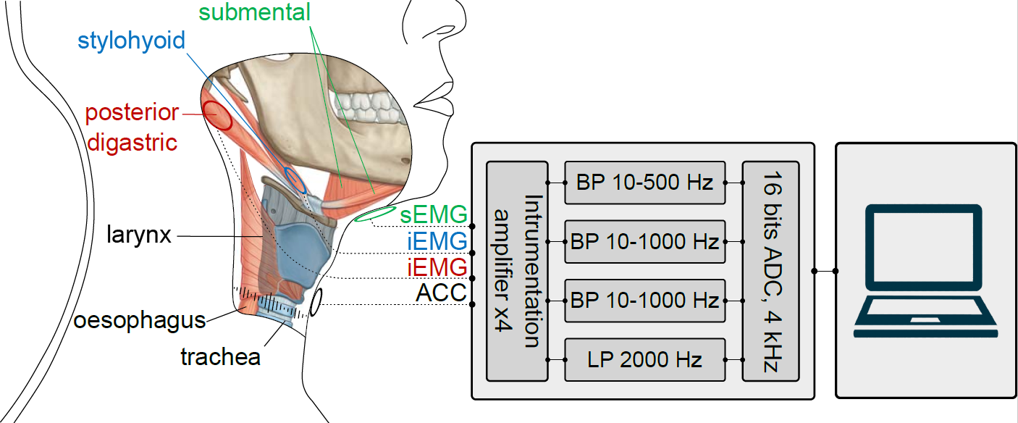
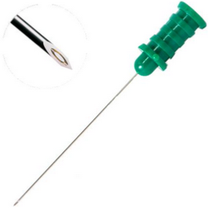

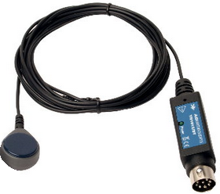
2. PRC – Innovative measurement method
(SM)
(SH)
(PD)
A. Mialland et al. Stylohyoid and posterior digastric measurement with intramuscular EMG, submental EMG and swallowing sound. In: BIOSIGNALS (2023)

Slide 23
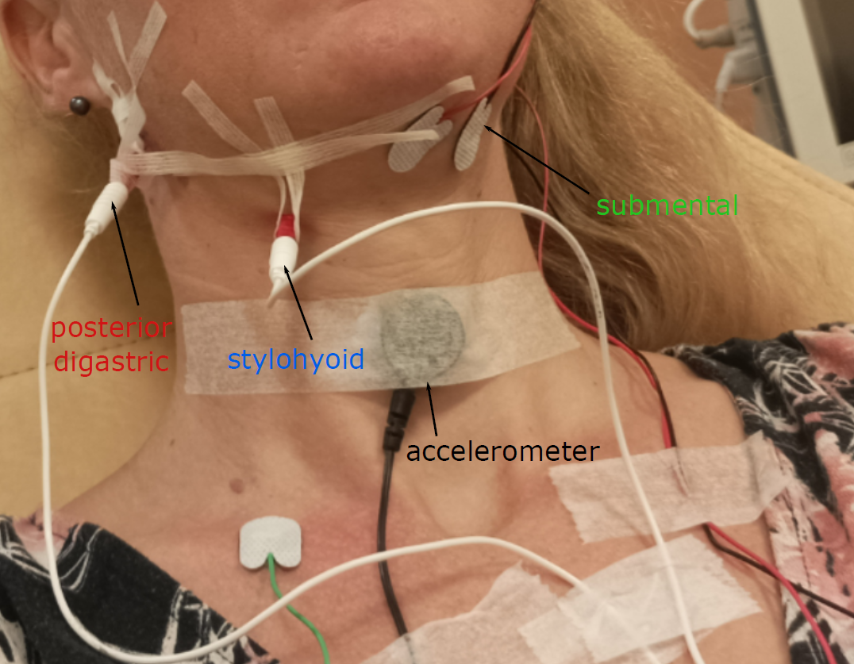
2. PRC – Innovative measurement method
(SM)
(SH)
(PD)
17 healthy participants (8 men / 9 women)
4 swallowing: saliva, water, thick (compote), solid (madeleine).
13 non-swallowing: mouth opening, lips purseing, teeth clenching, smiling, whistling, coughing, blowing, speaking, saying « iii », jaw movements, lateral head movements, head flexion/extension, mastication.
A. Mialland et al. Stylohyoid and posterior digastric measurement with intramuscular EMG, submental EMG and swallowing sound. In: BIOSIGNALS (2023)

Slide 24
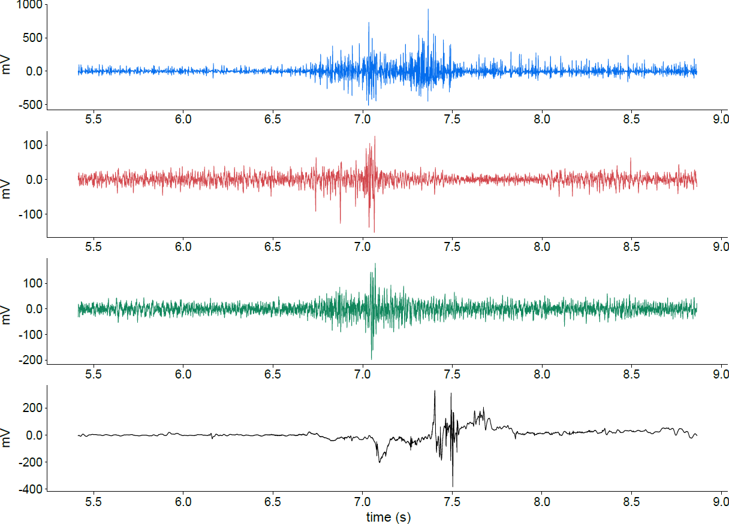
2. PRC – Innovative measurement method
Swallowing acquisition exemple
stylohyoïdien
Digastrique postérieur
Sous-mandibulaires
Son de la déglutition

Slide 25
Presentation Plan
Context
Clinical Research Protocol (CRP)
Statistical Study
Real time detection
Implantable Active Artificiel larynx (IAAL)
Conclusion and perspectives

Slide 26
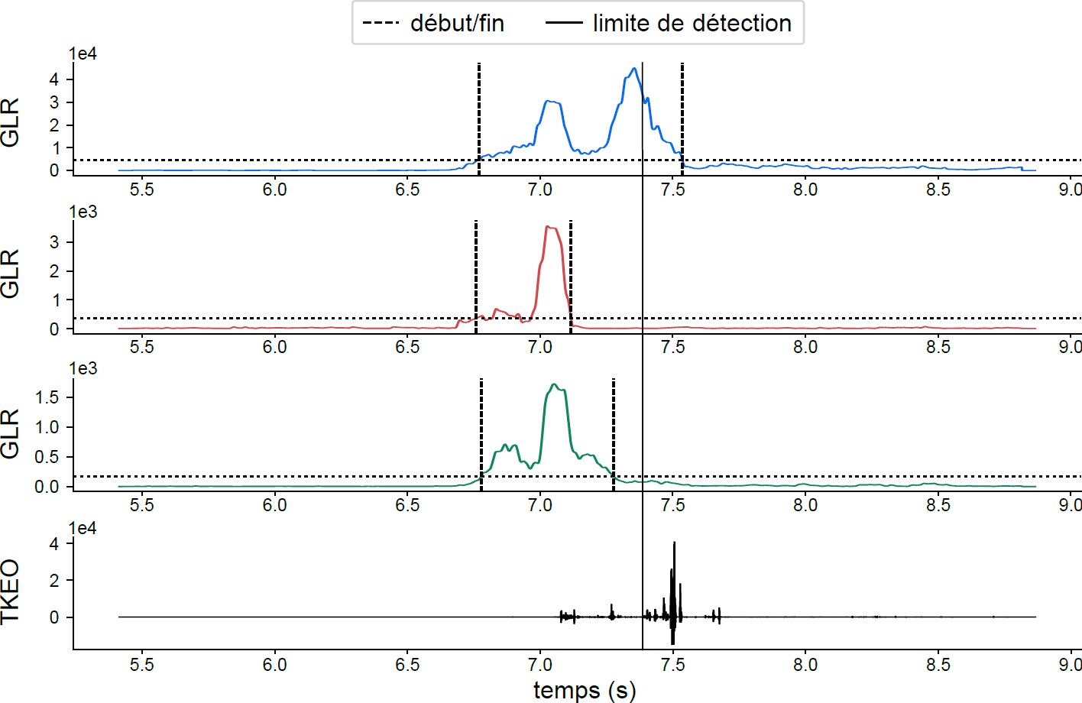
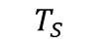

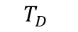
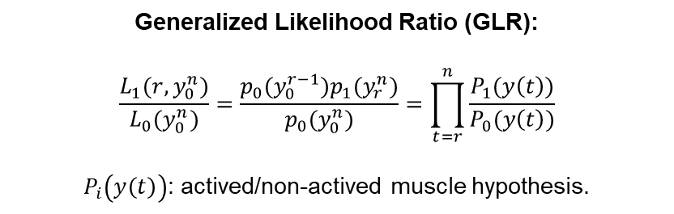
3. Statistical study– Data extraction
stylohyoid
beginning
Detection limit
mV
GLR
Posterior digastric
mV
$$T_{D}$$
$$T_{F}$$
GLR
Submandibular
mV
GLR
Swalloing sound
$$T_{S}$$
mV
TKEO
time (s)
time (s)
Generalized Likelihood Ratio (GLR):
$$\frac{L_{1}(r,y_{0}^{n})}{L_{0}(y_{0}^{n})}=\frac{p_{0}(y_{0}^{r−1})p_{1}(y_{r}^{n})}{p_{0}(y_{0}^{n})}=\prod_{t=r}^{n}{\frac{P_{1}(y\left(t\right))}{P_{0}(y\left(t\right))}}$$
$P_{i}\left(y\left(t\right)\right)$: actived/non-actived muscle hypothesis.
A. Mialland et al. Stylohyoid and posterior digastric measurement with intramuscular EMG, submental EMG and swallowing sound. In: BIOSIGNALS (2023)
Notes:
plausibilité

Slide 27
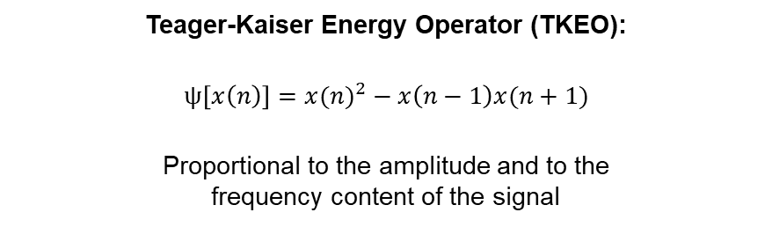
3. Statistical study– Data extraction
stylohyoid
beginning
Detection limit
mV
GLR
Posterior digastric
mV
$$T_{D}$$
$$T_{F}$$
GLR
Submandibular
mV
GLR
Swalloing sound
$$T_{S}$$
mV
TKEO
time (s)
time (s)
Teager-Kaiser Energy Operator (TKEO):
$$ψ\left[x\left(n\right)\right]={x(n)}^{2}−x\left(n−1\right)x(n+1)$$
Proportional to the amplitude and to the
frequency content of the signal

Slide 28
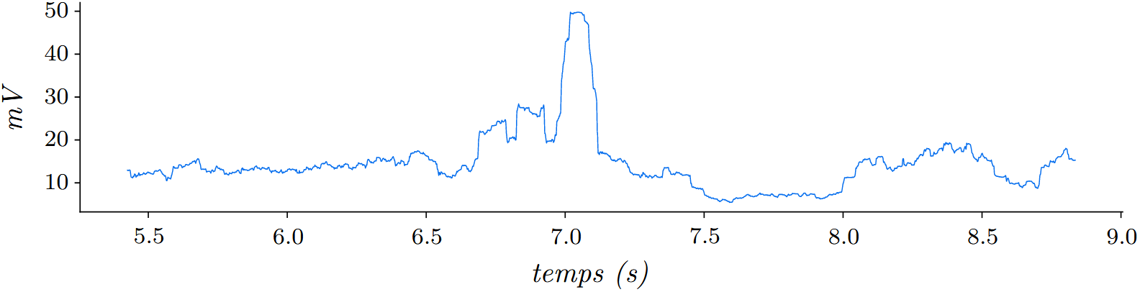

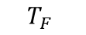


3. Statistical study– Data extraction
stylohyoid
beginning
Detection limit
mV
GLR
Posterior digastric
mV
$$T_{D}$$
$$T_{F}$$
GLR
Submandibular
mV
GLR
Swalloing sound
$$T_{S}$$
mV
TKEO
time (s)
time (s)
RMS amplitude: posterior digastric
$$T_{D}$$
$$T_{F}$$
RMS value of the samples contained
in a $200ms$ sliding window
mVRMS
temps (s)
$$T_{P}$$

Slide 29
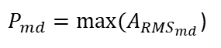
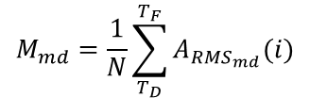
3. Statistical study– Data extraction
stylohyoid
beginning
Detection limit
mV
GLR
Posterior digastric
mV
$$T_{D}$$
$$T_{F}$$
GLR
Submandibular
mV
GLR
Swalloing sound
$$T_{S}$$
mV
TKEO
time (s)
time (s)
$$M_{md}=\frac{1}{N}\sum_{T_{D}}^{T_{F}}{A_{{RMS}_{md}}(i)}$$
RMS amplitude: posterior digastric
$$T_{D}$$
$$T_{F}$$
mVRMS
$P_{md}=max⁡(A_{{RMS}_{md}}$)
temps (s)
$$T_{P}$$

Slide 30
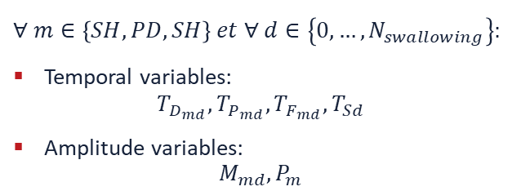
3. Statistical study– Data extraction
stylohyoid
beginning
Detection limit
mV
GLR
Posterior digastric
mV
$$T_{D}$$
$$T_{F}$$
GLR
Submandibular
mV
GLR
Swalloing sound
$$T_{S}$$
mV
TKEO
time (s)
time (s)
$$∀ m∈\left\{SH,PD,SH\right\} et ∀ d∈\left\{0, …, N_{swallowing}\right\}:$$
Temporal variables:
$$T_{D_{md}},T_{P_{md}},{T_{F_{md}},T}_{Sd}$$
Amplitude variables:
$$M_{md},P_{m}$$
RMS amplitude: posterior digastric
$$T_{D}$$
$$T_{F}$$
mVRMS
temps (s)
$$T_{P}$$

Slide 31

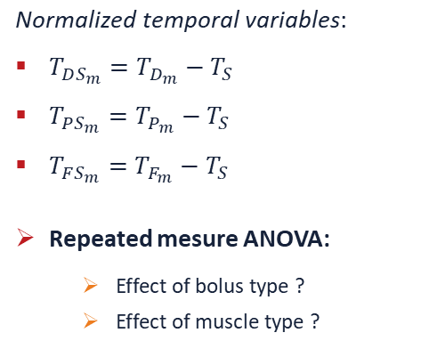

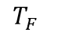
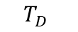
3. Statistical study– Timing analysis
$$\text{N}\text{ormalized} \text{temporal} \text{variables}\text{:}$$
$T_{DS_{m}}=T_{D_{m}}−T_{S}$
$T_{PS_{m}}=T_{P_{m}}−T_{S}$
$T_{FS_{m}}=T_{F_{m}}−T_{S}$
Repeated mesure ANOVA:
Effect of bolus type ?
Effect of muscle type ?
Start of Swallowing ?
Available
time ?
Tends to be dedicated to swallowing ?
Time (s)
$$T_{D}$$
$$T_{S}$$
$$T_{P}$$
$$T_{F}$$
A. Mialland et al. Stylohyoid and posterior digastric timing evaluation. In: BSN (2023)

Slide 32
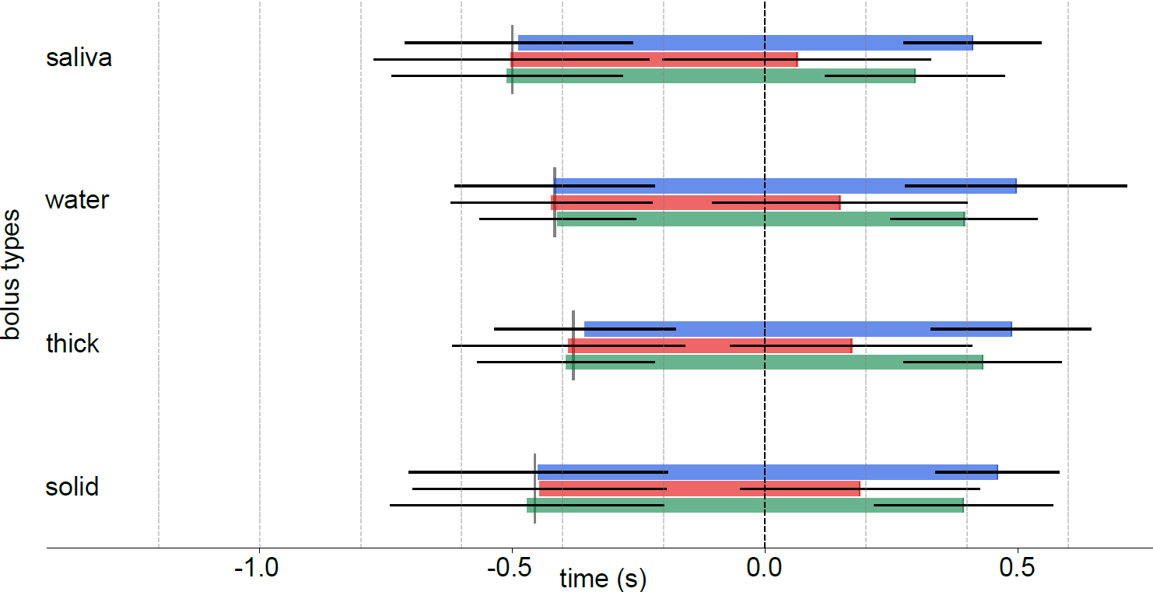
3. Statistical study– Timing analysis
*
**
peaks
means, : p<0,05, : p<0,01
Stylohyoid
Posterior Digastric
Stylohyoid
saliva
Posterior Digastric
Submandibular
Submandibular
*
Temporal limit
water
Type of bolus
**
thick
*
solid
time (s)

Slide 33
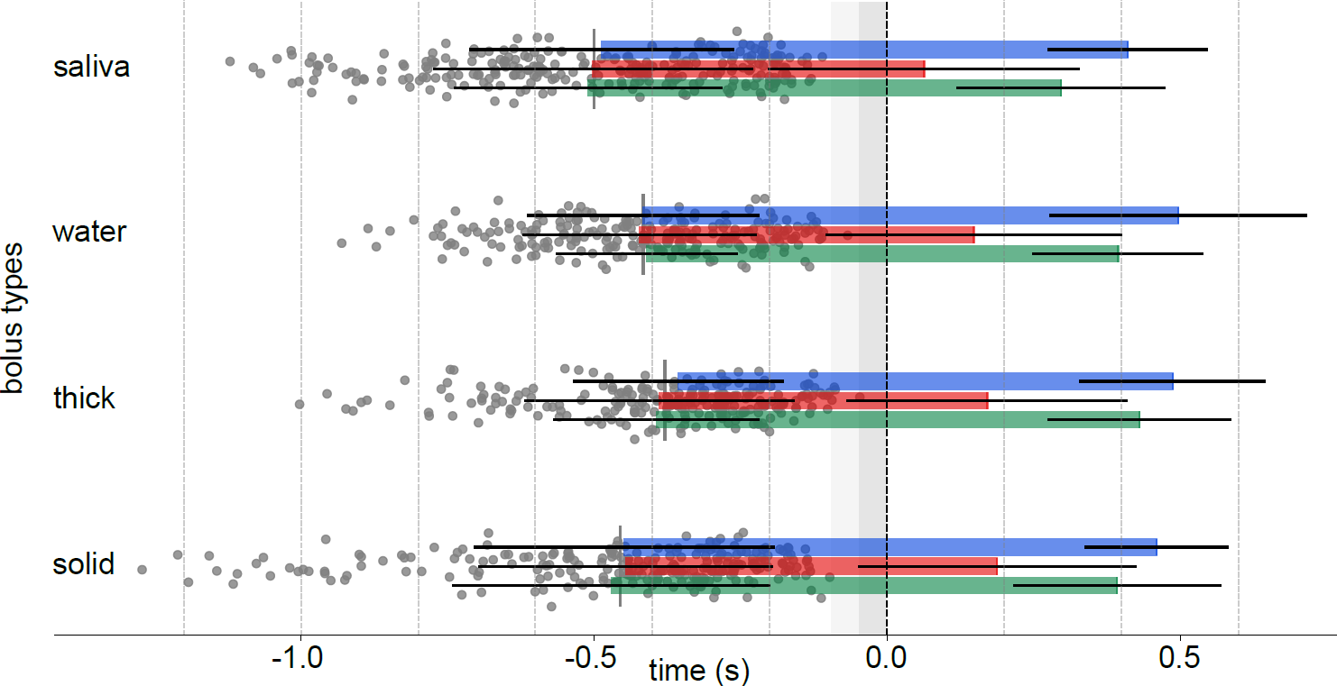
3. Statistical study– Timing analysis
*
**
peaks
onsets
means, : p<0,05, : p<0,01
Stylohyoid
saliva
Posterior Digastric
Submandibular
*
water
Type of bolus
**
-0,05s
-0,1s
thick
*
solid
time (s)

Slide 34
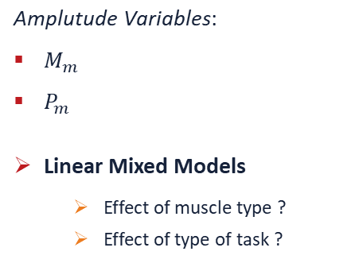
3. Statistical study– Recruitment pattern analysis
$$\text{A}\text{mplutude} \text{Variables}\text{:}$$
$M_{m}$
$P_{m}$
Linear Mixed Models
Effect of muscle type ?
Effect of type of task ?
Start of
Swallowing ?
Available
Time ?
Tends to be dedicated
To swallowing ?
Time (s)
$$T_{D}$$
$$T_{S}$$
$$T_{P}$$
$$T_{F}$$
A. Mialland et al. Stylohyoid and posterior digastric recruitment pattern evaluation in swallowing and non-swallowing tasks. In: IRBM (2023). Submitted

Slide 35
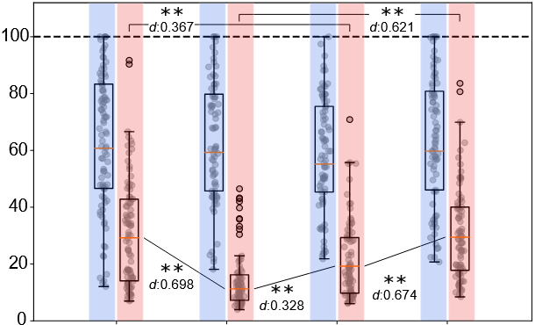
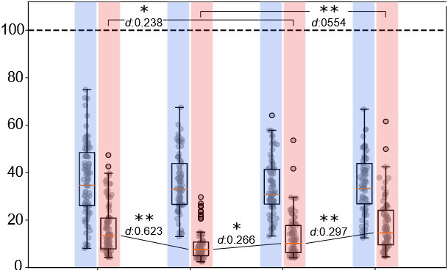
3. Statistical study– Recruitment pattern analysis
SH
mean
PD
Maximal swallowing
maximum
mean
Normalized RMS Amplitude (%)
Normalized RMS Amplitude (%)
saliva
water
thick
solid
saliva
water
thick
solid
Normalization: for each subject, the RMS signals are divided by the maximum value from all
the swallowing extracted from both the stylohyoid and posterior digastric muscles.
The posterior digastric has the smallest amplitude.
The stylohyoid has no significant variation depending on the type of bolus.

Slide 36
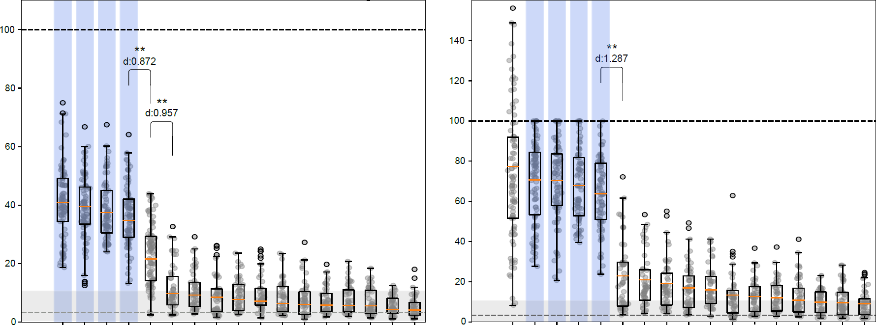
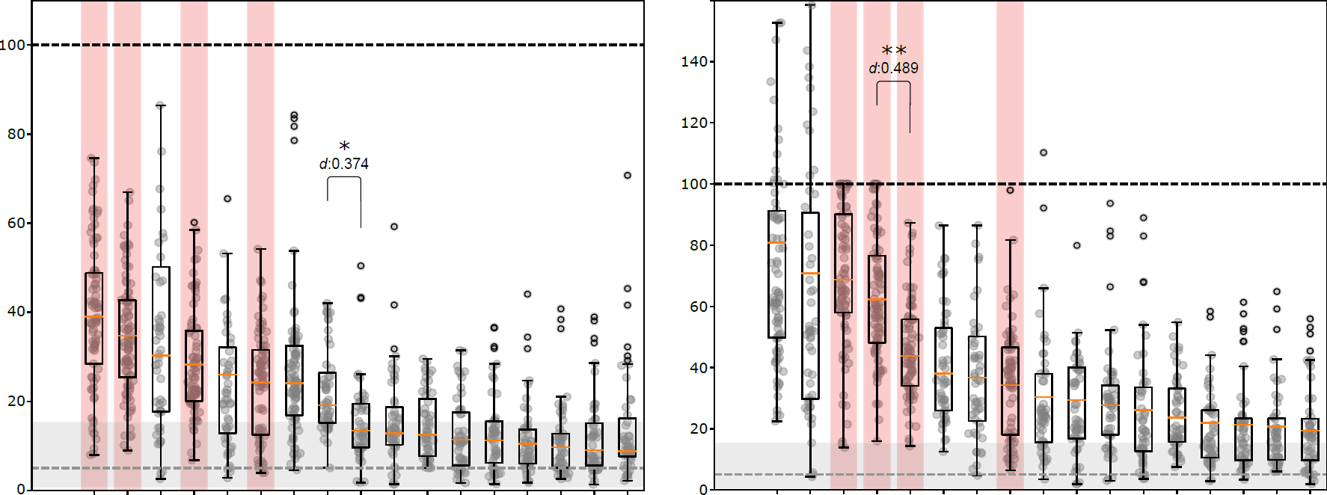
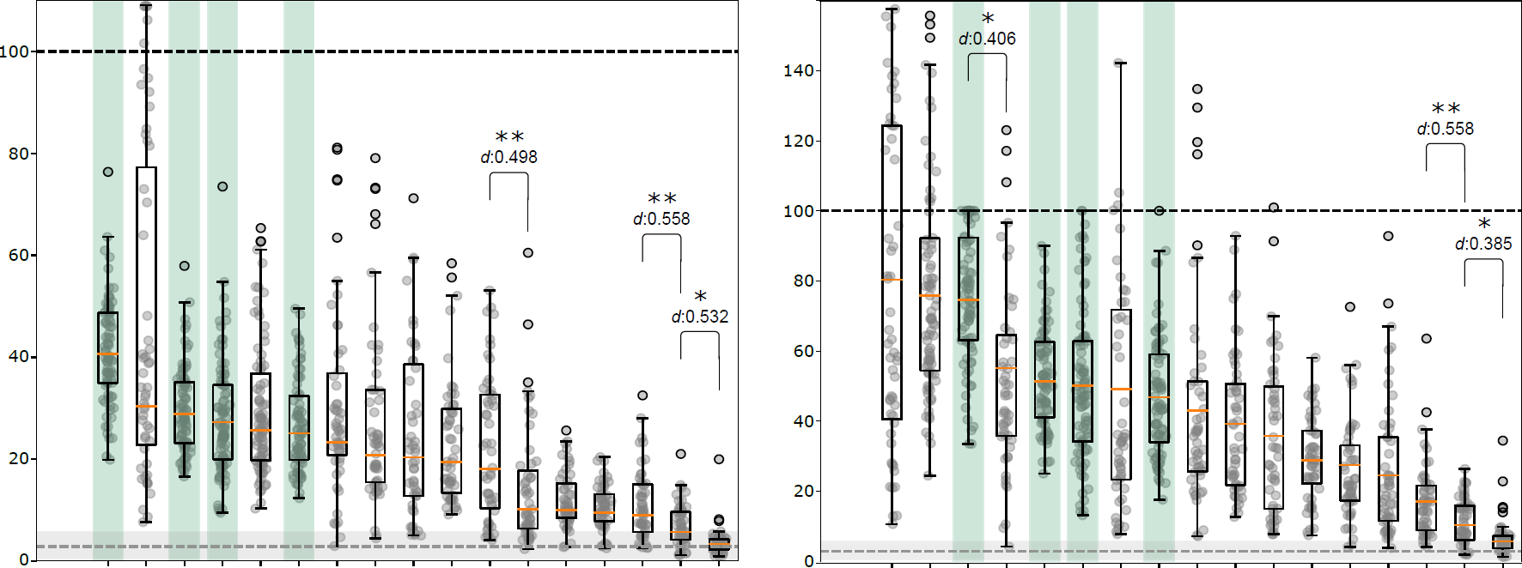
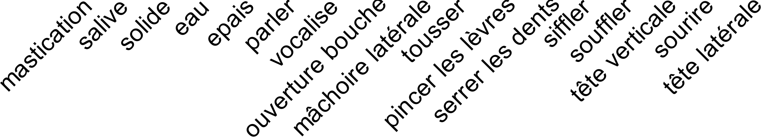


3. Statistical study– Recruitment pattern analysis
Acquisitions
Swallowings
mean
Median noise level
Noise: 75th percentile
stylohyoïdien
digastrique postérieur
sous-mandibulaires
Amplitude RMS normalisée (%)
Amplitude RMS normalisée (%)
Amplitude RMS normalisée (%)
Normalisation: for each subject, the RMS signals are divided by the maximum value from all
the swallowing, extracted from the currently considered muscle.
Net predisposition for swallowing of the stylohyoid. Trend for the posterior digastric.
No clear tendency for the submandibular muscles,

Slide 37
Presentation Plan
Context
Clinical Research Protocol (CRP)
Statistical Study
Real time detection
Implantable Active Artificiel larynx (IAAL)
Conclusion and perspectives

Slide 38


4. Real Time Detection – Literature Comparison
200ms window, step of 50ms
Reproduction of similar studies:
Constantinescu et al. 2018:
Surface EMG: submandibular muscles.
Swallowing, lips purseing, head movements, tongue movements.
swallowing, lips purseing, lateral head movements, head flexion/extension.
McNulty et al. 2021:
Healthy subjects and total laryngectomies
Surface EMG: submandibular muscles, diaphragm, intercostal muscles.
Swallowing, coughing, speaking, sit up, sit down, touch head, turn torso, walking.
Swallowing, coughing, speaking, saying "iii", head movements, head flexion/extension.
A. Phinyomark et al. 2017.
Boruta
LDA / SVM
A. Mialland et al. Stylohyoid and posterior digastric potential evaluation for a real-time swallowing detection, with intramuscular EMG. In: IEEE trans MRB (2023). Submitted

Slide 39


4. Real Time Detection – Literature Comparison
Comparing with Constantinescu et al.
precision : 83.9%, recall : 92.3%, F1-score : 87.9%
Comparing with McNulty et al. precision : 77%, recal : 57%, F1-score : 66%
The closest results to the literature.
Substantial increase with the stylohyoid muscle alone.
Potentiel synergestic effect between SH and PD muscles.

Slide 40
4. Real Time Detection – Literature Comparison
Method:
Sequential forward selection
swallowing
non-swallowing
Boruta
LDA / SVM

Slide 41


4. Real Time Detection – Literature Comparison
LDA: , SVM:
SH: stylohyoid , PD: posterior digastric , SM: submandibular
Classification performances (F1-score)
Incrementally adding the best scoring task to classification
The higher the rank, the harder the classification of the taks
Number of tasks added to swallowing

Slide 42

4. Real Time Detection – Literature Comparison
LDA: , SVM:
SH: stylohyoid , PD: posterior digastric , SM: submandibular
Classification performances (F1-score)
Mastication is always the 13th, causing the biggest drop
Number of tasks added to swallowing

Slide 43

4. Real Time Detection – Literature Comparison
LDA: , SVM:
SH: stylohyoid , PD: posterior digastric , SM: submandibular
Classification performances (F1-score)
6
rotation de la tête
3
2
2
1
Number of tasks added to swallowing
2,5

Slide 44


4. Real Time Detection – Literature Comparison
Inclusion rank of the task, for each
classifier and signal combination
Rang moyen de chaque tâche:
2,5: lateral head movements
From easiest to hardest to classify
3,2: head flexion/extension
3,7: coughing
5,4: lips purseing
5,5: whistle
5,8: clench teeth
6,6: smilling
7,3: saying « iii »
7,6: blow
9,3: speaking
10,3: jaw opening
10,8: lateral jaw movements
13: mastication

Slide 45
4. Real Time Detection – Participants subgroups
Method:
Agglomerative hierarchical clustering
C4
C1
C3
C1
P3
C2
P1
P2
P3
P4
P5
Boruta
LDA / SVM
Mean Euclidean distance between swallowing.

Slide 46

4. Real Time Detection – Participants subgroups
Effect of subgroups of participants
Greatest increase from the group containing all the participants

Slide 47

4. Real Time Detection – Participants subgroups
Cumulative Frequency
Missed muscle
capacity
Normalized % of detected swallowing
Groupe 1
Cumulative Frequency
Temporal detection limit
time (s)
All participants
Cumulative Frequency
time (s)
Groupe 2
time (s)

Slide 48
Presentation Plan
Context
Clinical Research Protocol (CRP)
Statistical Study
Real time detection
Implantable Active Artificiel larynx (IAAL)
Conclusion and perspectives

Slide 49
5. IAAL - Feasibility
Airway reconstruction
Active protective mechanism
[H. C. Grillo 2002] synthetic prosthesis are not effective.
Notes:
Stop l’activité biologique des cellules

Slide 50
5. IAAL - Feasibility
Airway reconstruction
vue de
A et B
Debry C. et al. 2014.
Notes:
Stop l’activité biologique des cellules

Slide 51

5. IAAL - Feasibility
Airway reconstruction
Functional tracheal prosthesis [H. Etienne et al. 2018, H. C. Grillo 2002 ]:
Longitudinal flexibility.
Rigidity.
Impermeability: respiratory epithelium.
Non-immunogenicity.
reliability et reproducibility of the method.
Biocompatibility of the materials.
E. Martinod et al. 2018
Notes:
Stop l’activité biologique des cellules

Slide 52

5. IAAL - Feasibility
Active protective mechanism
Functional protective mechanism:
Increased height of the trachea
Diversion of the bolus
Allow surgical intervention
Compatibility with radiotherapy
Allow expectoration of secretions
Prohibit any permanent closure
Closing speed
Small size
Upper esophageal sphincter

Slide 53



5. IAAL - Feasibility
Active protective mechanism
Implantable measurement:
K. A. Yildiz et al. 2020 (survey)
Vue et al. 2020, K. L. Burke et al. 2022:

Slide 54

5. IAAL – Laboratory Prototype
PC
UART
DMA
CPU
Power
Circuit
Protective
mechanism
Serial communication.
Real-time.

Slide 55



5. IAAL – Laboratory Prototype
PC
UART
DMA
CPU
Power
Circuit
Protective
mechanism

Slide 56



5. IAAL – Laboratory Prototype
PC
UART
DMA
CPU
Power
Circuit
Protective
mechanism
15mm
20mm
39mm
10mm
65mm

Slide 57


5. IAAL – Laboratory Prototype
Microcontrollers tested
Evaluated Configurations:
Classifiers: LDA, SVM, ANN
Window size: 200 samples, 400 samples
Window step: 50 ms
Signal combinations: SH-PD, SH-PD-SM

Slide 58




5. IAAL – Laboratory Prototype
Results per configuration
Speed camera (1000 fps):
Swallowing detection turns a LED on.
$T_{a}={T_{f}−T}_{LED}$
$T_{a}=22ms$
Total time worst case - 400 samples, SH-PD-SM, ANN:
$T_{T}=22$ + 3,27 = 25,27ms

Slide 59
Presentation Plan
Context
Clinical Research Protocol (CRP)
Statistical Study
Real time detection
Implantable Active Artificiel larynx (IAAL)
Conclusion and perspectives

Slide 60
6. Conclusion and perspectives
Stylohyoid (SH) and posterior digastric (PD) muscles measurement:
Innovative measurement method with intramuscular electromyography.
Timings:
SH and PD muscles activates at the beginning of swallowing.
Earliness of PD muscle activity.
Amplitude:
Predisposition of SH muscle to swallowing.
Stability of SH muscle.

Slide 61



6. Conclusion and perspectives
Real time detection:
Significant improvement in detection Accuracy with SH muscle alone.
Significant improvement in Earliness of detection with PD muscle alone.
Potential synergistic effect between SH and PD muscles.
Implantable active artificial larynx:
Measurement and airway reconstruction methods are promising.
Laboratory prototype actuated in 25,27ms.
$$\overline{T_{D}}≈−427ms$$
Beginning of swallowing
Moment of activation of
Measured muscles
0 secondes
Limite de détection
temps
Interval of activation of
the measured muscles
Signal processing
($3,27ms$)
Actuation of the
System ($22ms$)

Slide 62
6. Conclusion and perspectives
Research of additional information on neck activity.
Development of a active protective mechanism of the trachea.
Evaluated the hypotheses of total laryngectomees.
Elaboration of a algorithm with strong temporal constraints.
Evaluation of corner cases: vomiting, sleep, evolution through time, …

Slide 63
Publications
International peer-reviewed journals:
Survey
A. Mialland, I. Atallah et A. Bonvilain. “Toward a robust swallowing detection for an implantable active artificial larynx : a survey”. In : Medical & Biological Engineering & Computing (2023), p. 1299-1327. doi : 10.1007/s11517-023-02772-8.
Articles
A. Mialland, I. Atallah et A. Bonvilain. “Stylohyoid and posterior digastric potential evaluation for a real-time swallowing detection, with intramuscular EMG”. In: IEEE Transactions on Medical Robotics and Bionics (2023). Doi: 10.1109/TMRB.2023.3336960.
A. Mialland, I. Atallah et A. Bonvilain. “Stylohyoid and posterior digastric recruitment pattern evaluation in swallowing and non-swallowing tasks”. In : Innovation and Research in BioMedical engineering (2023). Doi: 10.1016/j.irbm.2024.100823.
A. Mialland et al. “Submental MechanoMyoGraphy (MMG) to Characterize the Swallowing Signature”. In : Innovation and Research in BioMedical engineering (2021). doi : 10.1016/j.irbm.2021.05.001.
International peer-reviewed conference:
A. Mialland, I. Atallah et A. Bonvilain. “Stylohyoid and posterior digastric measurement with intramuscular EMG, submental EMG and swallowing sound.” In :Biomedical Engineering Systems and Technologies (2023). Lisbonne. doi : 10.5220/0011628100003414.
A. Mialland, I. Atallah et A. Bonvilain. “Stylohyoid and posterior digastric timing evaluation”. In : Body Sensor Networks (2023). Boston. Doi: 10.1109/BSN58485.2023.10331308.
Internationale conference:
A. Mialland, I. Atallah et A. Bonvilain. The inherent complexity of an implantable active artificial larynx. Recherche en Imagerie et Technologies pour la Santé. Brest. 2022.
Nationale conference:
A. Mialland, I. Atallah et A. Bonvilain. Vers la faisabilité d’un larynx artificiel implantable actif. Société Française de Phoniatrie et Laryngologie. Tours. 2021.
Clinical research Protocol:
A. Mialland, I. Atallah et A. Bonvilain. Detection of Early Swallowing Time by Electromyogram and Sound Recording in Healthy Volunteers. https://clinicaltrials.gov/. Protocol ID : 38RC22.0096.2022.

